Slide 1
IBM DATA SCIENCE CAPSTONE COURSE
Finding an optimum location for a new hotel in Prague

Slide 2
Introduction and background
Since the fall of the Iron Curtain, Prague has become one of the world's most popular tourist destinations. Prague is classified as an "Alpha-" global city according to GaWC studies, comparable to Vienna, Manila and Washington, D.C. Prague ranked sixth in the Tripadvisor world list of best destinations in 2016.
Let’s say that hotel chain wants to open a new hotel in Prague, but is not sure of which neighbourhood it should choose. Before beginning this project, I looked up Prague hotels and found out that most of the hotels are clustered near the city centre, close to the river Vltava and to the commercial hubs with lots of shops, parks and other amenities.

Slide 3
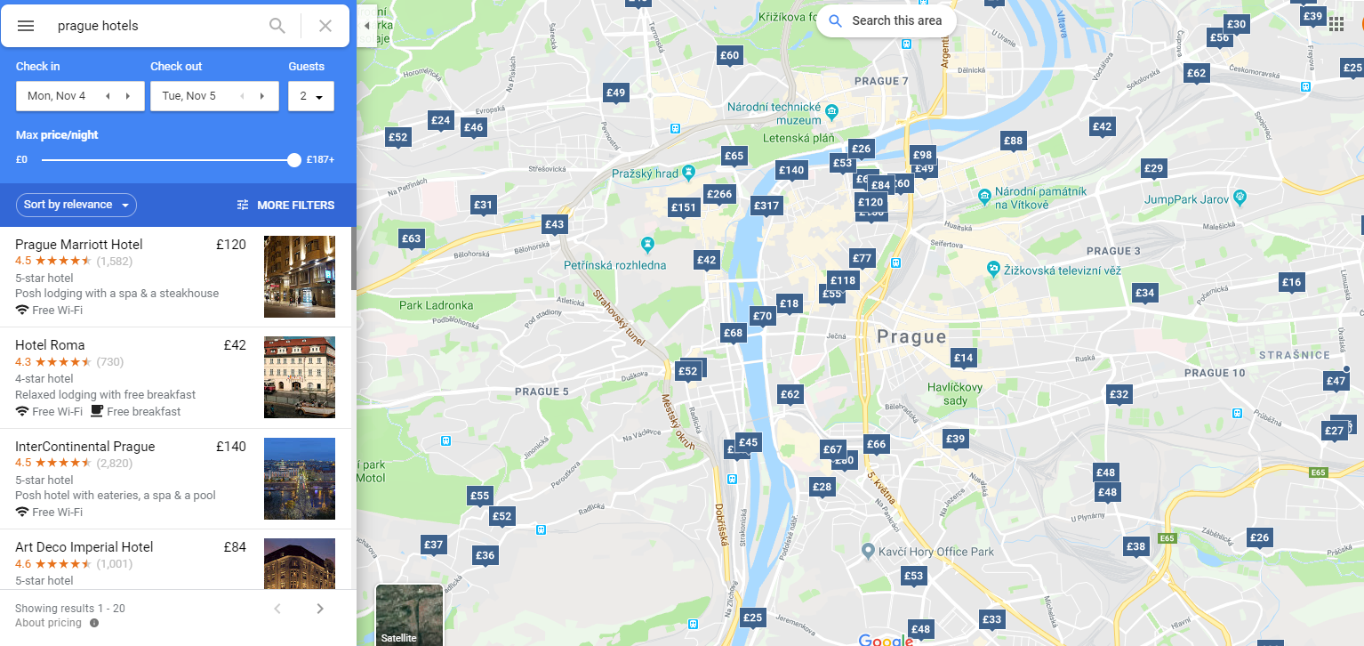
Hotels in Prague clustered around Commercial hubs

Slide 4
The business problem
I thought of analysing which other Prague neighbourhoods have a variety of parks and open spaces, low competition in terms of other hotels, as well as surrounding venues which match the target demographic of the hotel chain, i.e. tourist families.
Question: In the city of Prague, if a hotel chain targeting tourist families is planning to open a new hotel, where would you recommend to open it?
This data may prove useful to hotel chains who are looking to expand into Prague’s constantly expanding tourism market but also look at viable but not overcrowded locations for their property.

Slide 5
DATA used
List of neighbourhoods in Prague, which all serve as possible options for the hotel chain - https://en.wikipedia.org/wiki/Districts_of_Prague
Latitude and Longitude coordinates of each of these neighbourhoods, which would help visualise them and their surroundings on a map.
Venue data in order to locate parks, other hotels and surrounding venues that would help in the analysis and clustering of neighbourhoods.

Slide 6
methodology
I scraped data about the 10 neighbourhoods in Prague from the Wikipedia page with the help of Python requests and the beautifulsoup package.
I then used the Geocoder package to get the geographical coordinates for each of the neighbourhoods.
After that, I used the Foursquare API to get venue data for each of these neighbourhoods, i.e. surrounding landmarks, attractions and places to visit. Based on that data, I gained insights to the number of parks present in each neighbourhood.
Using machine learning techniques like K-means clustering, I calculated and clustered neighbourhoods which have a high number of parks and open spaces and then visualised them using Folium, a map visualisation library.
I narrowed down to a cluster of 2 neighbourhoods with higher number of parks.
For both of the remaining neighbourhoods, I calculated the 10 most common venues and judged which of them fit the target demographic of the hotel chain better, thus concluding the optimum neighbourhood for opening a new hotel in Prague.

Slide 7
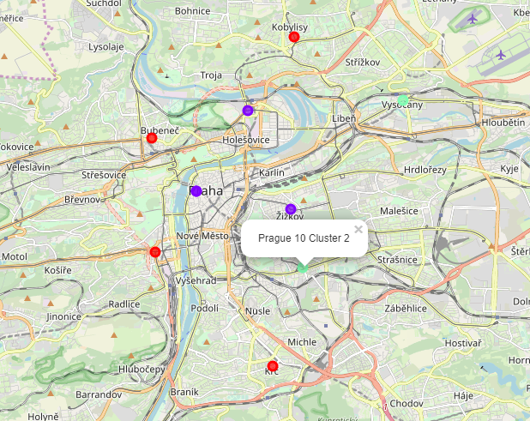
Neighbourhoods clustered around parks and commercial hubs. Purple - low frequency, Red - medium frequency, Green - high frequency
RESULTS

Slide 8
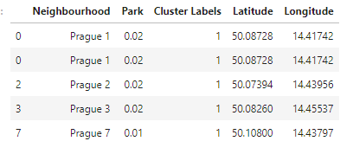

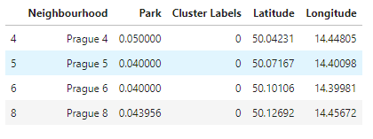
Low Frequency Cluster
Medium Frequency Cluster
K-MEANS CLUSTERING ON MEAN OF FREQUENCY OF PARK OCCURRENCE IN NEIGHBOURHOODS
High Frequency Cluster

Slide 9
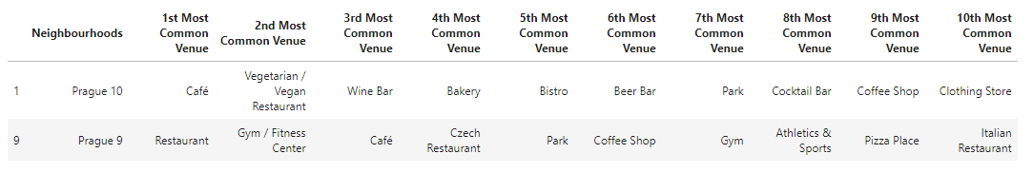
TOP 10 COMMON VENUES IN CLUSTER NEIGHBOURHOODS WITH least HOTEL COMPETITION

Slide 10
DISCUSSION
From these observations, I thought that the given the target demographic of the hotel are tourist families, Prague 10 matches this demographic more than the other neighbourhoods. The presence of a train station and a bus stop close to the neighbourhood would be an important factor for tourists. Furthermore, cafes, restaurants and parks are more common in this neighbourhood than others. Prague 9 would be a close second option, but Prague 10 has an advantage of being closer to the city centre, train and bus stop, which would make travel easier for tourists.
However, this data closely depends on the venues and data obtained from the Foursquare API with free account where number of calls is limited. Additional data should have been obtained on the other factors like safety and accessibility of the neighbourhood. Ii also discards neighbourhoods with a lot of parks and already existing hotels. These areas should be explored in the future.

Slide 11
EVALUATION
However, this data depends on the venues and data obtained from the Foursquare API. On a sandbox API, the number of calls is limited.
Furthermore, additional data should have been obtained on other factors like safety and accessibility of the neighbourhood.
It also discards neighbourhoods with a lot of parks and already existing hotels. It may not be mandatory for the neighbourhood to have no nearby hotels at all for the new hotel to do well there.
It also assumes that the hotel chain would want to open a hotel near a park, and not near, say the Vltava river or any other popular spot. I would recommend these abovementioned areas as future possibilities to explore.
Also, if the hotel chain chooses to target a demographic like working adults and open a business hotel, the choice of neighbourhood would definitely be different.

Slide 12
CONCLUSION
However, assuming the hotel is targeting tourist families with children, opening a parkside hotel would be highly recommended and Prague 10 would be an ideal neighbourhood to open a new hotel, given that other factors like safety and accessibility check out.

